Slide 1

The Child with a Skin Condition Chapter 30 Niomi Quinteros BSN, RN

Slide 2
Integumentary System
Differences between children and adults:
Thin epidermis in infants
Absorption is dramatically greater
Skin is drier and chaps easier
Less subcutaneous fat-more sensitive to heat and cold
Ability to perspire through the skin matures by 3 years of age so thermoregulation may be a problem

Slide 3
Functions of the Skin
Protection- first line of defense
Regenerates and repairs

Slide 4
Integumentary System
Maintaining skin integrity- physiological and psychological impact
4 basic skin sensations
Pain
Temperature
Touch
Pressure
Secretes sebum

Slide 5
Integumentary System
Two layers
Epidermis
Dermis
Vernix caseosa
Lanugo

Slide 6
Assessment of the Skin
Color – wide variations
Texture
Moisture
Rashes
Bruising/discolorations
Thickness
Hair and fingernails

Slide 7
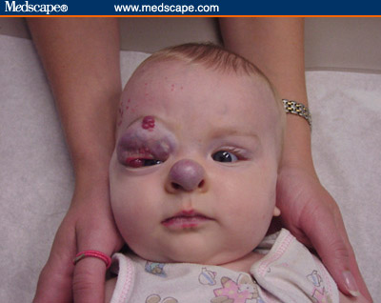
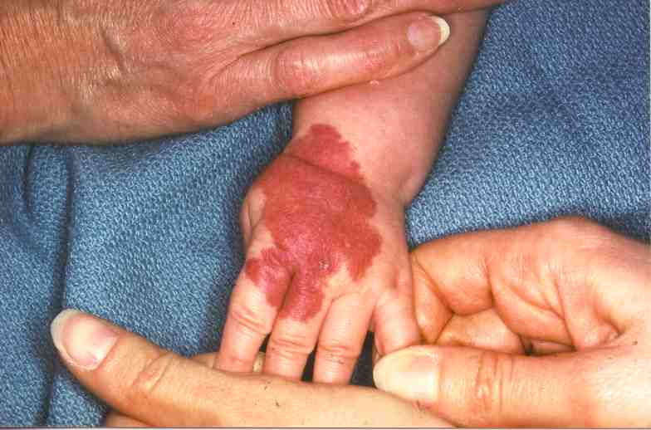
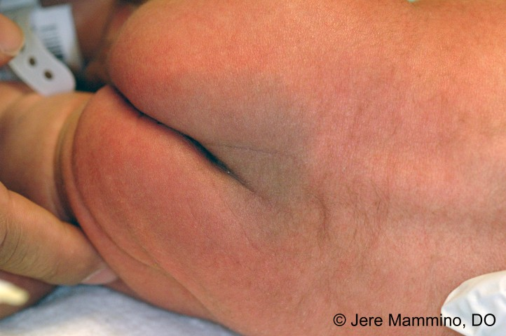
Skin Conditions in Infancy
Milia
Strawberry nevus
Mongolian spots
Portwine nevus

Slide 8
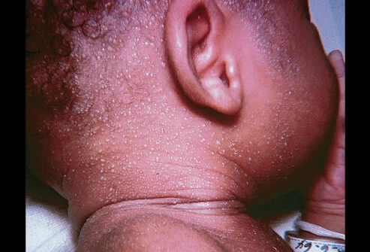
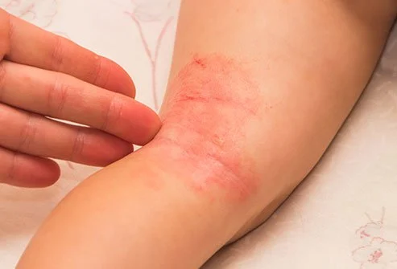
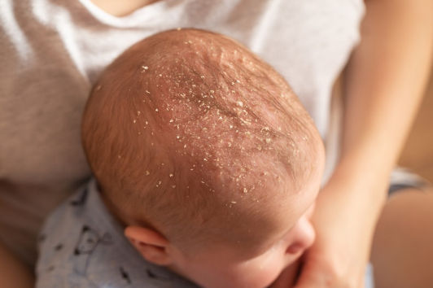
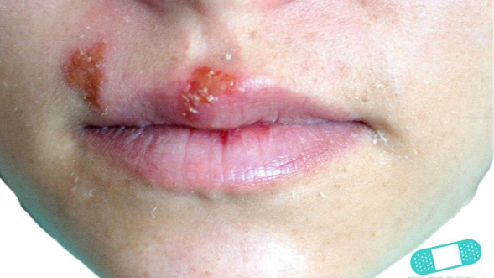
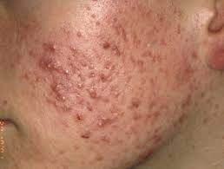
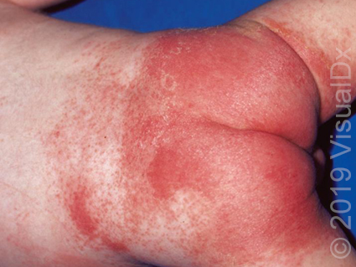
Skin Infections
Miliaria
Intertrigo
Seborrheic dermatitis
Diaper dermatitis
Acne Vulgaris
Herpes simplex, type I

Slide 9
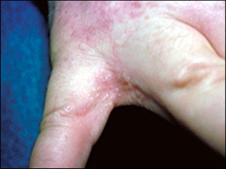
Eczema
Avoid overheating
Avoid exposure to skin irritants
Improve skin hydration
Admin of meds (antihistamines, topical steroids)
Seems to follow a definite familial history of allergies and asthma
Goals of management:
Relieve pruritus
Hydrate skin
Reduce inflammation
Prevent/control secondary infection

Slide 10
Staphylococcal Infection
Primary infection may develop in a newborn in the umbilicus or circumcision wound.
May occur while in hospital or after discharge
Infection may enter bloodstream, leading to septicemia.
Small pustules on a newborn must be reported immediately.
Antibiotic ointments are used in some situations; in others, intravenous antibiotics are required.
If an infant has MRSA, the child is placed in contact isolation if hospitalized.

Slide 11
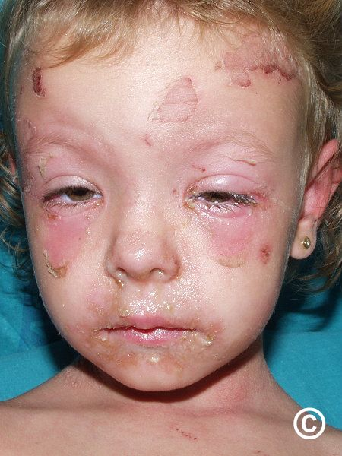
Scalding Skin Syndrome
Caused by Staphylococcus aureus
Lesions begin with a mild erythema with a sandpaper texture.
Vesicles appear, and rupture and peeling occur, exposing a bright-red surface.
Skin appears scalded, and child abuse is often suspected.
Generally heals without scarring

Slide 12
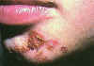
Impetigo
Caused by staphylococci or group A beta-hemolytic streptococci
Bullous form seen in infants usually staphylococcal
Nonbullous form seen in children and young adults
Newborns susceptible because resistance to skin bacteria is low
Very contagious
Treatment is either oral or parenteral antibiotics

Slide 13
Fungal Infections
Treatment
Tinea Capitis
Tinea Corporis
Tinea Pedis
Tinea Cruris
Tinea Capitis
Griseofulvin
Avoid exposure to the sun
Tinea Corporis, Tinea Pedis, and Tinea Crurus
Clotrimazole (Lotrimin AF)

Slide 14
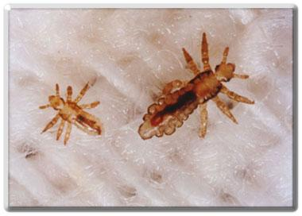
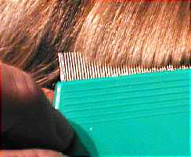
Pediculosis
Capitis (head lice)
Corporis (body lice)
Pubis (pubic lice)
Treatment:
Nix, Rid, Pronto, comb dipped in 1:1 solution white vinegar and water; Ovide for resistant bugs may need to retreat

Slide 15
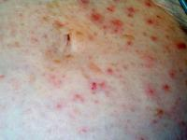
Scabies
Parasitic infection
Rarely seen on face
Body folds and between fingers
Intense itching especially at night
Treatment:
Elimite; everyone in close contact needs to be treated.

Slide 16
Burns
Leading cause of accidental death between 1 and 4 years of age
Types of burns include
Thermal—caused by fire or scalding vapor or liquid
Chemical—caused by corrosive powder or liquid
Electrical—caused by electrical current passing through the body
Radiation—caused by x-rays or radioactive substances

Slide 17
Children’s Response to Burns
Thinner skin
Larger BSA
Increased metabolism
Smaller muscle and fat content
Skin is more elastic
Immature immune system
Growth/Development issues

Slide 18
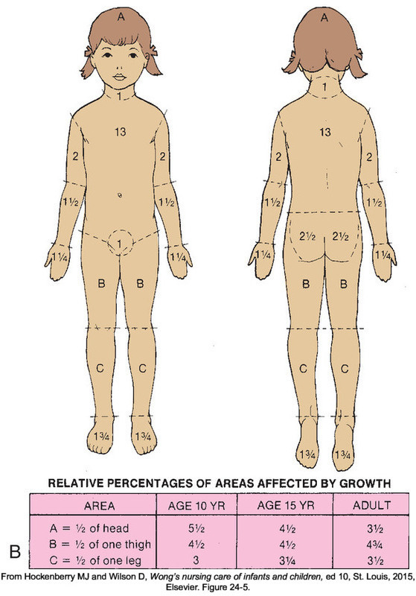
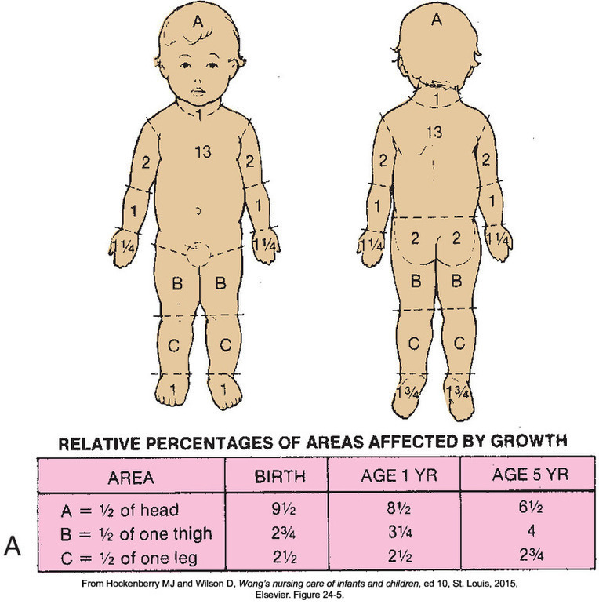

Slide 19
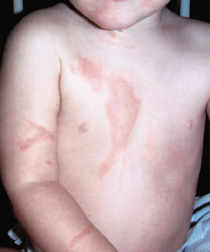
Superficial (1st degree)
Epidermis only
Usually heals in 5-10 days
Treatment:
Immerse in cold water; apply ointment
Examples:
Sunburn, hot water

Slide 20
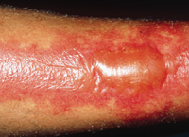
Partial Thickness (2nd degree)
Epidermis and much of dermis
Treatment
Apply antimicrobial ointment if area is small
Larger areas immerse in cold water and cover to prevent contamination
Avoid breaking blisters

Slide 21
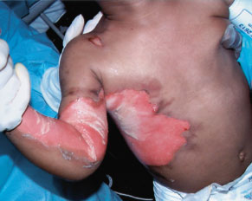
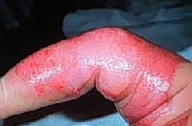
Deep Dermal
Appears red, waxy; is very painful
Sweat glands and hair follicles are not affected.
Healing takes place in about 30 days, usually with extensive scarring.

Slide 22
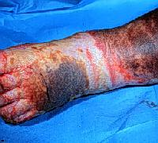
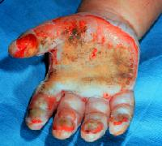
Full Thickness
Appears leathery, black or pearly white. Painless to touch, but surrounding tissue is very painful.
Nerve endings, sweat glands and hair follicles are destroyed.
Extends into SQ tissue

Slide 23
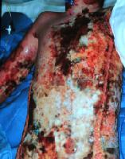
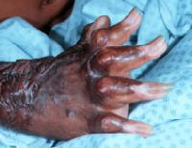
Secondary and Tertiary Complications From Burns
Secondary Infection
Disfigurement

Slide 24
Emergency Care of Burns
Stop the burning process.
Assess the victim’s condition.
Cover the burn.
Transport to a medical facility.
Provide reassurance to family.

Slide 25
Burn Care
Minor
Wound cleansing, antimicrobial ointment, loose dressing, pain relief
Usually cared for on outpatient basis.
Major
Establish airway, IV lines, lab studies, Foley cath, NG tube, wound assessment/management, escharotomy

Slide 26
Burn Care
Wound Care
Can be painful; pain medications should be given in advance of the treatments to ensure adequate pain control is achieved.
Cleansing and débridement
Loss of skin increases threat of infection and fluid loss caused by evaporation can be significant.
Nursing Care
Protective isolation is instituted.
All instruments are sterile.
Ointments are applied with a sterile gloved hand or sterile tongue depressor.
Care must be taken to avoid injury to granulating tissue.

Slide 27
Grafting
Permanent
Autograft
Isograft
Temporary
Homograft
Heterograft
Porcine xenograft
*Tanner mesh graft
*”Postage-stamp” graft
*Full cover (sheet) graft

